Slide 1
MOVIES DATASET
ANALYSIS

Slide 2


OVERVIEW
01
02
Our Team
Problem statement
03
04
Analysis and visualization
Final insight

Slide 3



OUR TEAM
Nader Mohamed
Youssef Othman
Amr
sherif
Khaled Mohamed
Shahd
Ibrahim
Hager
Ahmed

Slide 4



PROBLEM STATEMENT
The movie industry is highly competitive, with numerous factors influencing the success of a film. Understanding the key elements that contribute to a movie's financial performance and audience reception can provide valuable insights for filmmakers, production companies, and marketers.

Slide 5

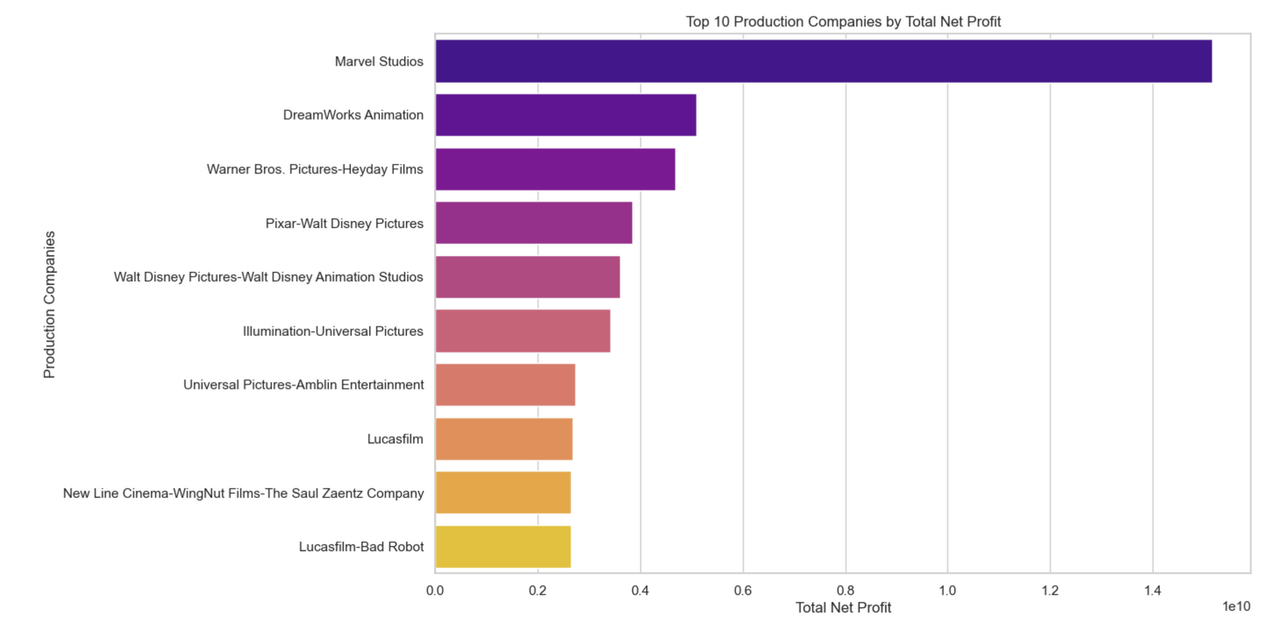
What is the Top 10 Production
Companies by Total Net Profit?
The visualization highlights how top production companies dominate the industry by generating substantial profits, showcasing industry leaders and their commercial success.

Slide 6
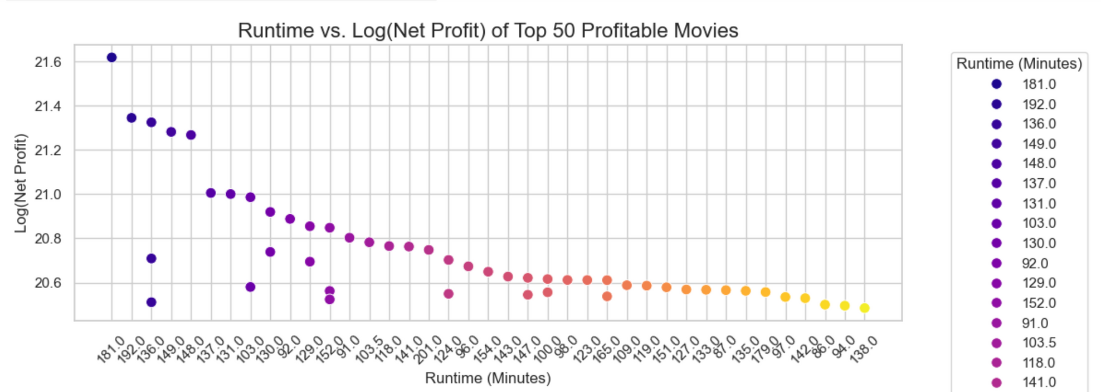
Do longer movies tend to have higher net profits?
This analysis examines the relationship between movie length and financial success, exploring whether longer runtimes lead to higher revenues or diminishing returns. It offers insights to help filmmakers optimize runtime for profitability

Slide 7
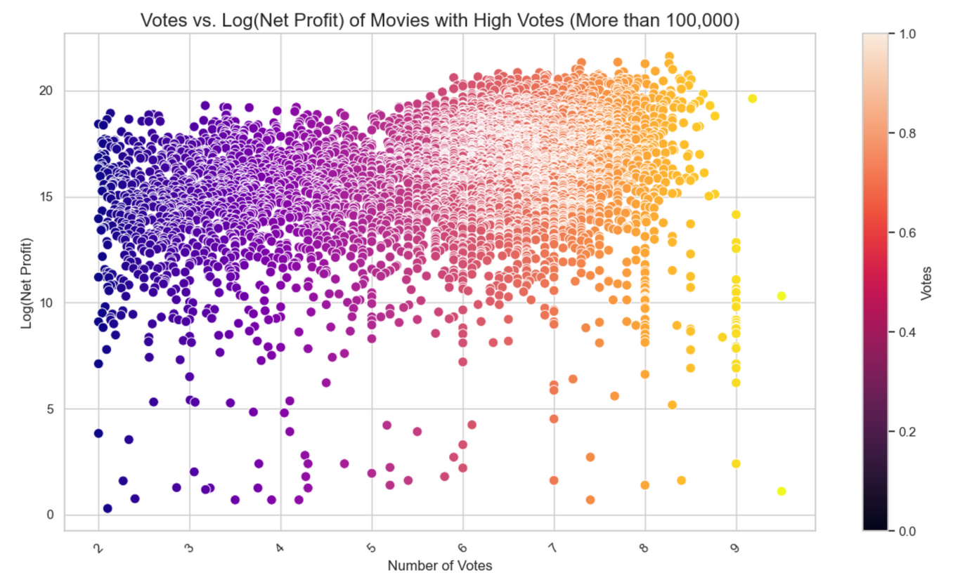
Do movies with higher vote counts tend to be more profitable?
This analysis explores the correlation between audience engagement, measured by votes, and profitability, emphasizing the role of fan reception in driving a film's financial success and the value of building a strong audience base.

Slide 8
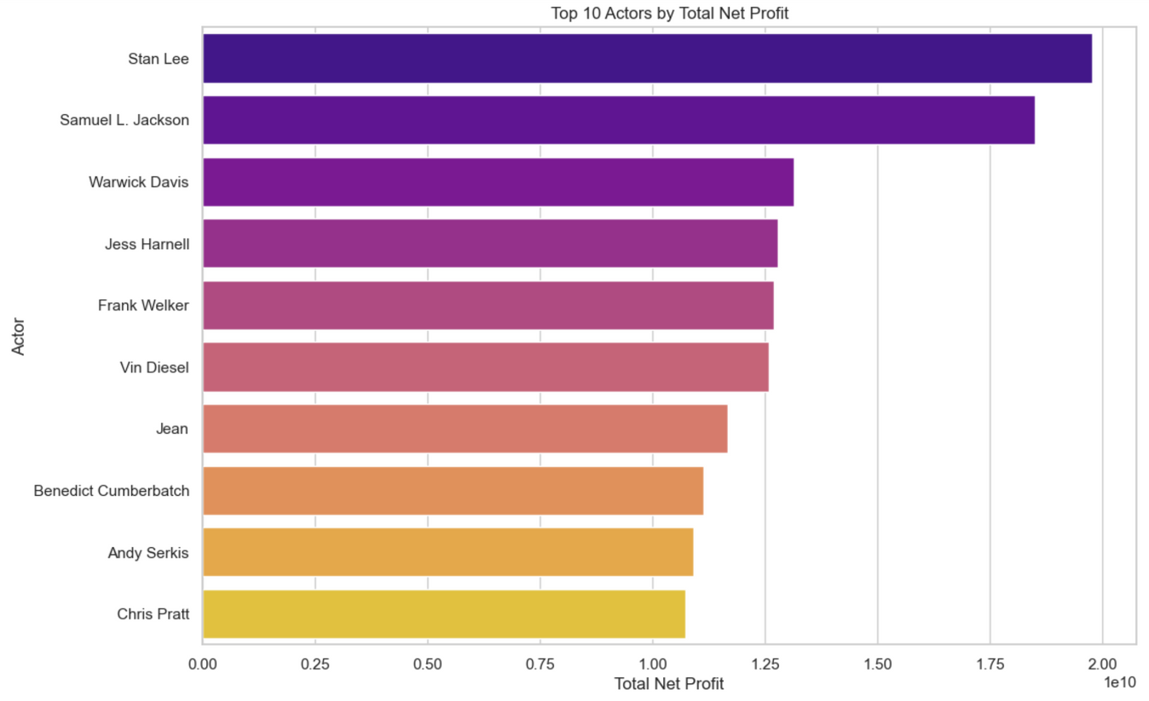
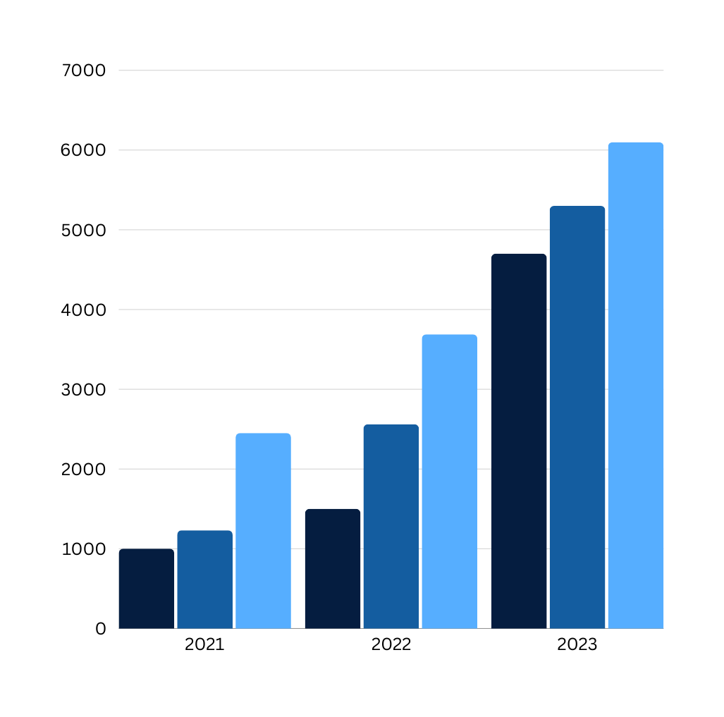
Which actors are most strongly associated with a movie's profitability, and how does their presence in a film impact its net profit?
The analysis highlights the impact of star power on profitability, revealing how leading actors significantly influence box-office success and emphasizing the importance of strategic casting decisions.

Slide 9

PROFITABILITY IS THE COMMON FACTOR ACROSS ALL ANALYSES, AS IT IS INFLUENCED BY THE MOVIE'S LENGTH, AUDIENCE ENGAGEMENT, AND CASTING CHOICES. FINANCIAL SUCCESS RELIES ON BALANCING THESE ELEMENTS TO ATTRACT VIEWERS AND MAXIMIZE REVENUE.

Slide 10
Thanks For Watching

